Slide 1
MONETIZING THE MEDALLION
A Data-Driven Method of Increasing Cab Traffic
Anup Tirumala, Max Lee, Sarah Cha, Tianhao Xu
Dr. Edward Fine
Berkeley Data Science w205-3
August 22, 2017

Slide 2
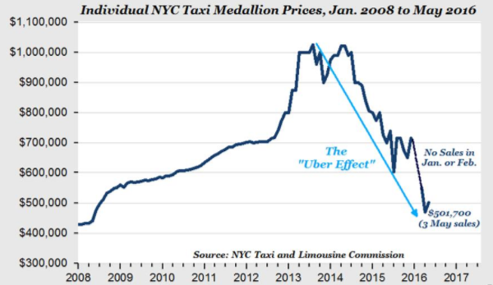
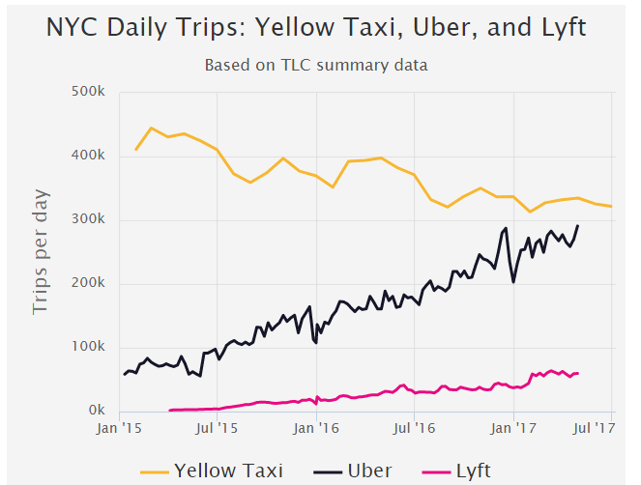
Identification of Business Need
New York City Taxi Medallions award the holder the right to drive in the metropolitan area. As the population of Manhattan exploded, medallions reached values north of $1 MM in 2014.
Advent of market-disrupting technologies like Uber and Lyft as well as increasing cost of living has dramatically reduced taxi revenues, with a medallion printing a price $240k earlier in 2017.
However, a declining functionality of the NYC subway system, deemed in a “state of emergency” by Governor Cuomo earlier this year has presented an opportunity for some market share recovery.
Figure 1: Taxi value has plummeted...¹
Figure 2: … while competitors grow²
Bloomberg
Law
Independent Analytics
Lexis Nexis
Lexis Nexis
Westlaw
Bloomberg
Law
Westlaw

Slide 3

Demonstration of Visualization
Bloomberg
Law
Independent Analytics
Lexis Nexis
Lexis Nexis
Westlaw
Bloomberg
Law
Westlaw

Slide 4
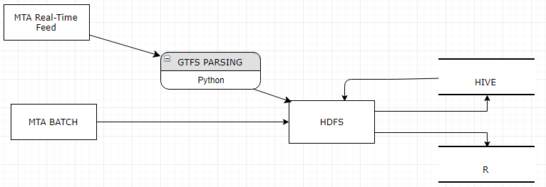
Data and Implemented Architecture
Current data was taken from the Metropolitan Transportation Authority (MTA) website and API. The MTA is the operator of public transit in the NYC Metropolitan Area. Various types of real-time, batch, and static files are available.
Figure 3: Basic Implemented Data Architecture
Original design proposed using Storm to handle streaming, but further examination showed that the feed was updated every 30 seconds.
Batch data is updated on a daily and weekly basis. Shell scripts written that import new data into HDFS as well as appending to relevant HIVE tables.
Independent Analytics
Lexis Nexis
Bloomberg
Law
Westlaw

Slide 5
Batch Data: Turnstile
Entries and exit into subway stations are recorded at turnstile permission points. Data is recorded every four hours per station per line.
Our intended goal was identifying areas of high foot traffic / congestion, the breakout by line and time provides an additional layer of detail that contributes higher specificity.
As an example, rather than noting Grand Central has the most turnstile clicks on a daily basis, we are able to account for the fact that grand central has the most lines and is a commuter hub to other neighborhoods like Long Island.
Data is released on a weekly basis in txt file to the MTA website. We scrape these files into HDFS which are pulled into R as well as pushing to HIVE for spot specific SQL queries.
Historical data is availavle from October 2014. A weekly batch file is available which updates HIVE table with schema-on-read imposed.

Slide 6
Batch Data: Schedules
The schedule data was last updated in June 2017, and it consists of files on scheduled stop times, stop locations (including GPS coordinates), route descriptions, transfer times, and lookups for calendar days.
We utilized the stop times and stop locations data. This gave us a mapping of each route, the physical location and name of each stop, and the time at which a subway train was supposed to be at a particular stop.
We are then able to compare the time that a train was scheduled to be at a station against the actual time, and allowed us to determine in real time if a train was delayed:.
One thing we noticed about the real time updates is that there wasn’t often a delay specified, but we did notice the real time updates often would not match the scheduled time. Based on the MTA documentation and our observations, it appears that often the schedule will just update when there is a delay, rather than there being a recorded delay (think of how a bus board might keep displaying 10 min for 5 min rather than 5 min delayed). Our comparison of the updated time against the schedule time allows us to catch these delays.

Slide 7
Real-Time: Updates and Delays
MTA’s API provides updates in GTFS-RT every 30 seconds (approximately)
Trip Updates, Vehicle Positions, Alerts.
GTFS-RT is an implementation of Google Protobuf with NYC extensions.
We leverage the Python bindings that Google provides
The size of each update is ~300MB (per 30 secs, ie. throughput of 10MB/s)
EBS gave ~125MB/s for writes and ~6.6GB/s for reads (1M block size)
Hive Query processing time: 120 - 180 seconds on shared node
Rendering Time in RShiny: 11 seconds on the same shared node
Using batch architecture for prototyping

Slide 8
Visualization Implementation
The goal was to create an interactive visualization that allows the user to see real-time updated congestion/subway traffic patterns in an easily digestible format.
We arrived at the conclusion that a map with dashboard type features would help achieve this the best.
After comparing with Tableau, we settled on R Shiny because it is code-based (R-based), making feed updates of real-time data pretty easy from a speed and execution perspective, while its FluidPage feature makes it pretty easy to split the page up into different pieces of a dashboard that you can adjust and move around to meet changing needs. With R as the underlying language, the ability to perform advanced analytics on the incoming data and manipulate the data was pretty seamless.

Slide 9
Limitations
Data is coerced to a known form, csv, in order to meet timeline and progress with visualizations. This is not a time/memory efficient method, which limits applicability to faster responding machines and programs (real-time analytics, self-driving taxis, etc.), and further iterations would work to directly take real time and batch updates.
Serving layer restricted to line updates with historical average coloring. Further resources would be spent to develop the analytics.
Does not make use of historical data to provide any type of predictive measure.
The “baseline” schedule may not always be up to date and this affects the accuracy of our delay predictions and could also exclude new lines from being shown.

Slide 10
Scaling and Improvements
Alternative data can be leveraged to improve ex ante outputs.
Framework from exercise 2 was leveraged to track tweets with “nyc subway” as well as following specific MTA account. In both instances, we found a very high frequency of empty spouts which did not warrant the addition to structure at this time, but we still believe there is a potential to make utilize information from social media.
Weather is often a major determinant in transportation decisions, especially given that subways are not door-to-door solutions.
Non-focus MTA data such as busses and normal traffic data can add an additional layer of real-time detail.
Scaling to by adding alternative transportation data across other geographical domains.
Many major metropolitan areas have a main public transport system that, coupled with Uber and Lyft, have displaced taxi revenue. Once a more nuanced architecture is finalized, we should be able to augment it with GTFS data, weather, social media, etc. data from other cities.

Slide 11
Questions?
Bloomberg
Law
Independent Analytics
Lexis Nexis
Lexis Nexis
Westlaw
Bloomberg
Law
Westlaw

